Slide 1
CS4499/5599: Data Science and Applied Machine Learning
Class Lecture: February 6th, 2023

Slide 2
Objectives
Last time:
Plotting using pandas functions
Introduction to Seaborn
Today:
pandas filters, Lambda functions and .apply()
Pandas .loc and .iloc
Assign Homework 3

Slide 3
Pandas Filter
Now that we have some visualization tools, we should cover a few more pandas functions that we will use
In data science getting our datasets in the proper format can be the most complicated challenge
The .filter() method can allow us to remove all the unnecessary data and create DataFrames that are better suited for our purposes

Slide 4
Pandas .apply()
Very rarely outside of academia will a data scientist control all mechanism for data collections and storage
As such it is very common that you will need to make a specific change to an entire column of data
Some common cases are that data is entered incorrectly, data is in the incorrect format, etc.
.apply() is a useful method in these cases
We can use .apply() to perform an operation (usually a function of some sort) on an entire field at once

Slide 5
Pandas Lambda
Lambda functions are helpful approach for applying functions to our dataset
Lambda functions are just temporary functions we can apply to our DataFrame
We can use the following format to apply the functions:
lambda parameter_arguments : return_expression

Slide 6
Pandas .loc and .iloc
Pandas filters can be very useful, however, there is a much better approach that we can use to select rows and columns in our DataFrames
The .loc and .iloc methods are two of the most used methods in pandas
These methods are used to select groups of specific rows and/or columns
Due to the similar names they are often confused with one another, so we will go over both in detail

Slide 7
Pandas .loc
Pandas .loc is used when we are working with labels (i.e. Strings) for our rows and columns
With .loc we can look for a specific value within our dataset
Or we can look for a group of values that meet our criteria
We can use any of our common logic operators (==, <,>, <=. >=, !=, etc.) with .loc/,iloc

Slide 8
Pandas .iloc
Pandas .iloc is used when we are working with numerical values (i.e., Integers) for our rows and columns
Just like with .loc, with .iloc we can look for a specific value within our dataset or a series of values
This is the only difference between the two, but it is not uncommon to get the two mixed up

Slide 9
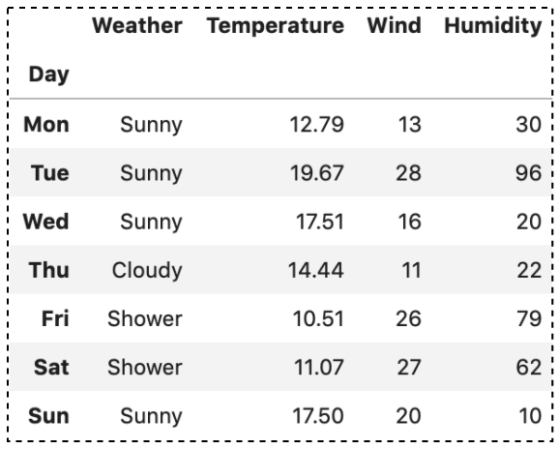
.loc Example
The typical format for .loc() is:
df.loc[df[row_label], df[col_label]]
A basic query with the data from table would look like
df.loc[ ‘Fri’, ‘Humidity’]
What does this return?
Example create by Bindi Chen of Apple

Slide 10
.iloc Example
The typical format for .iloc() is:
df.iloc[df[row_#], df[col_#]]
A basic query with the data from table would look like
df.iloc[ 5, 2]
What does this return?
Example create by Bindi Chen of Apple

Slide 11
Slicing with .loc/.iloc
While finding single values can be useful we also want to use .loc/.iloc to show entire (or part of) rows & columns, this is called slicing
We can specify the range of the value using the : operator
The first number in our range is the starting point is included for both rows and columns
The last number is the end point which is included with rows but NOT columns
If we leave an argument blank it will assume all the entire range

Slide 12
Slicing Examples
List all column values for a given row:
df.loc[:, ‘col_name’] OR
df.iloc[:, col_num]
List all row values for a given column:
df.loc[‘row_name’ , :]] OR
df.iloc[row_num’ , :]]
List all column values for rows from m to n :
df.loc[m:n, :] OR
df.iloc[m:n, :]

Slide 13
Slicing Examples
List all row values for a specific column(s) (in order):
df.loc[ :, [‘col_name_1’,… ‘col_name_n’]] OR
df.iloc[:, [col_num_1,… col_num_n]]
List all row values for a given range of column(s):
df.loc[ :, ‘col_name_start’ :‘col_name_end’ ] OR
df.iloc[ :, ‘col_num_start’ :‘col_num_end’]
List a range of rows using a step for all columns
df.loc[m:n:s, :]
df.iloc[m:n:s, :]

Slide 14
Slicing with Conditions
The final capability we will go over is slicing based on conditions
To apply our condition with .loc all we have to do is specify the condition when we specify the row and column slices
Using .iloc is more tricky where we may have to convert our conditions to list (Hint: stick with .loc)
We can apply conditions to both our row and column slice

Slide 15
Slicing with Conditions Example
Single Condition (all rows & columns that meet condition)
df.loc[df[‘col_name’] >= value, :]
df.loc[list(df[‘col_name’] >= value), :]
Multiple Conditions (Use & operator and () to divide the conditions )
df.loc[(df[‘col_name’] >= value) &, (df[‘col_name_2’] == value_2) &, :]
df.iloc[list((df[col_num] >= value) & (df[col_num_2] == value_2)) , :]

Slide 16
Dropping Columns & Rows
There are going to be times where you will need to remove columns or rows from your dataset
The .drop() method makes this easy, as you only have to choose the column/row name(s) (or number)
However, it is important to note that you must specify the axis when you use .drop
axis=0 will look to drop a row (default)
axis =1 will look to drop a column
Ex: df.drop([‘col_1_name’, ‘col_2_name’], axis=1)
Ex: df.drop([col_num_1, col_num_2])

Slide 17
Common Pandas Methods
This list of common methods should help you throughout the class:
mean() Returns the average value over requested axis
.mode() Returns the mode over requested axis
.std() Returns Standard Deviation over requested axis
.sum() Returns sum of values over requested axis
.max() Returns max value of requested axis
.min() Returns minimum value over requested axis
.idmax() Returns index of first occurrence of maximum over requested axis.
.idmin() Returns index of first occurrence of minimum over request axis

Slide 18
Common Pandas Methods
This list of common methods should help you throughout the class:
.unique () Return unique values based on a hash table
.nunique() Counts the number of distinct elements in specified axis.
.count() Count non-NA cells for each column or row.
.value_counts() Returns a pandas series containing counts of unique values.
.sorted_values() Sort by the values along either axis.
.astype() Cast a pandas object to a specified dtype
.dtypes() Return the dtypes in the DataFrame

Slide 19
Next Time
You should all be able to do Homework 3 that will be due next week on 2/13
If you get stuck the pandas documentation is a good quick resource
Next time we will begin discussing the role of statistics in data science

